Slide 1
Pens & Printers!
Visualization & Reporting
By
Chris mundy, Data Analyst

Slide 2
KPI & Analysis Overview
Decrease in revenue by 23%
Popularity of products via region
Null product identification
Other Patterns?
Notes:
I’m excited that you have tasked me with provided some reporting and data visualization on your KPI’s. As the Head of Sales, I can understand your concern for the decrease in revenue by 23%. I am going to provide some visualizations on which products are popular in a given region, identify which products do not sell in certain regions, and a pattern I have noticed that may help drive future marketing/sales tactics.
Further, managements query of discerning popularity of products via region, which products do not sell in some locations, and interest in other patterns of data is appropriate.
In the following slides I have provided 3 visualizations from the data provided to shed some light on managements inquires.

Slide 3
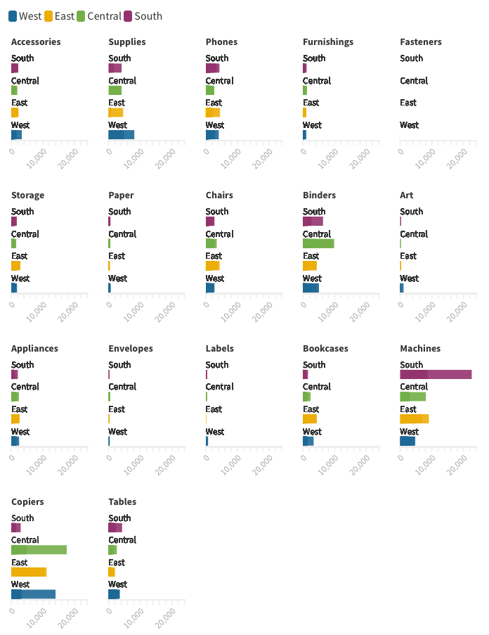
Product Popularity
In the central, west & east regions, copiers are the most popular product
In the south, machines dominate sales
Notes:
I’ve utilized a data analysis program called Flourish to display Product Popularity. Given this analysis, we can see that copiers and machines are the most popular product at pens and papers.
Of note, copiers are the most popular product in the central, east & west regions.
In the south region, machines dominate the market.

Slide 4
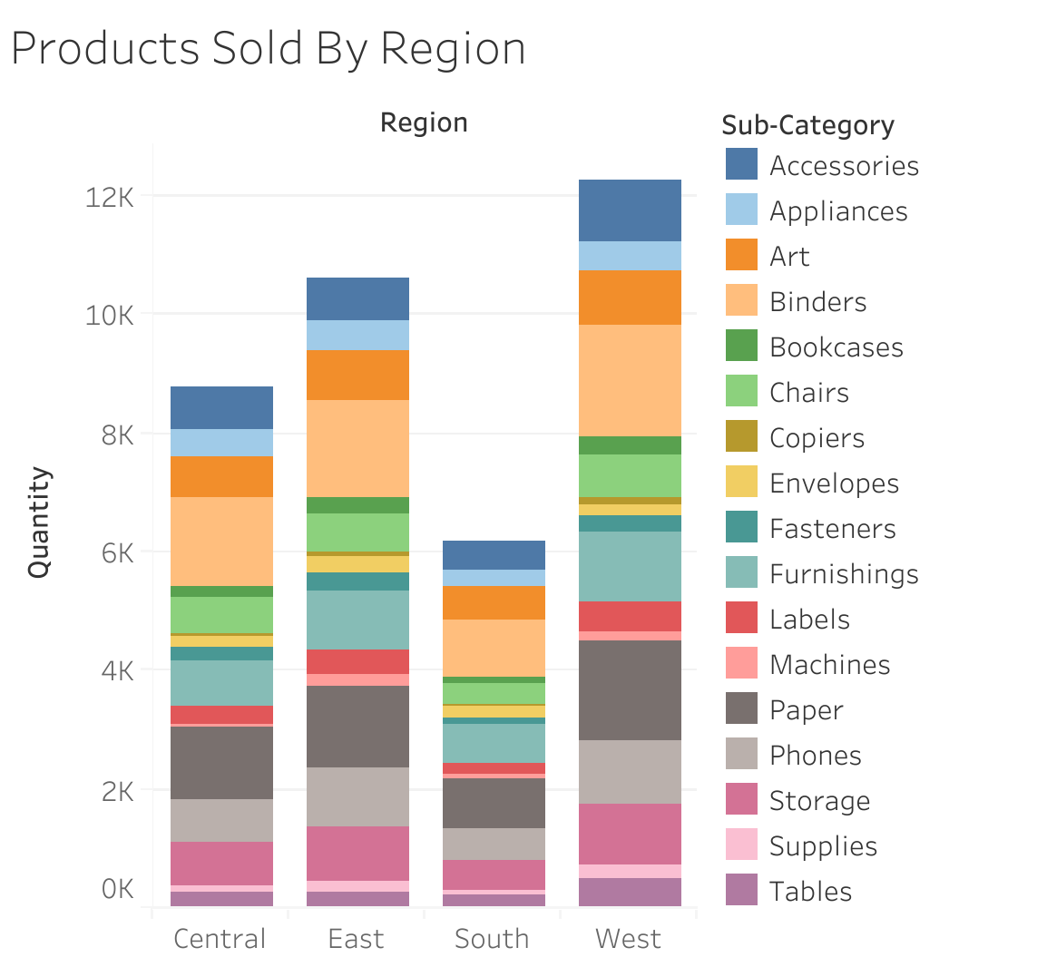
Notes:
Similarly, if we take a look at this visualization table, which is a stacked bar chart, we can see that tables, supplies, and storage do not sell well in any region and as in the case with tables, not at all.

Slide 5
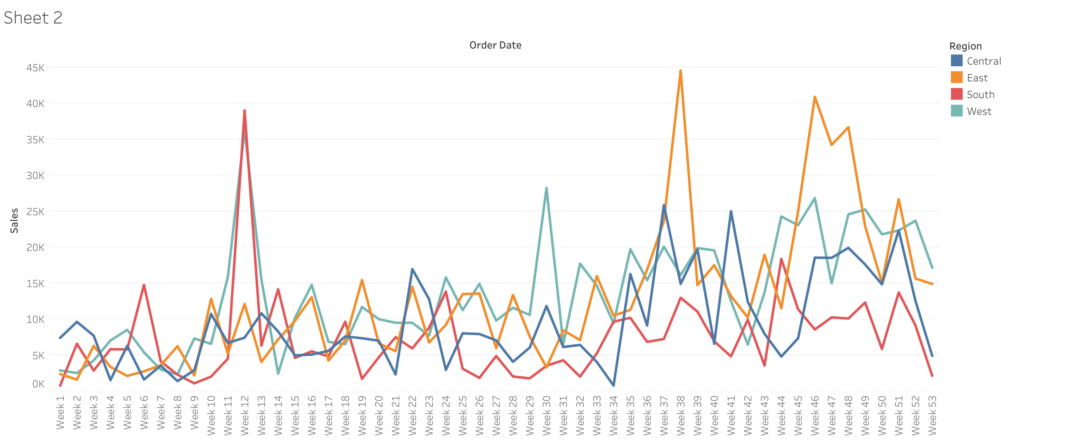
Notes:
I’ve utilized the data visualization tool, Tableau, to take a deeper dive into the data have included this line chart to help with some predictions, or predictive analysis. As you can see there are times of the year in which certain regions have a dramatic increase in sales. It could be beneficial to utilize this data to shape how and when Pens & Printers markets their products to a given region. Also, this chart can be helpful in guiding when the company decides to deploy discounts to certain regions.

Slide 6
Insights & recommendations
Pens & papers can capitalize on these data visualizations to reduce the 23 % drop in revenue by:
focusing on their most popular products; copiers and machines
removing products such as tables that sell poorly or not at all in each region
utilize the predictive analysis that i have provided to forecast product sales via region and appropriate times of the year to increase/decrease discounts to clients

